Slide 1



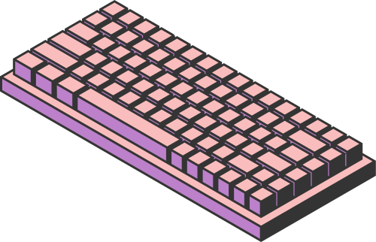
REAL-TIME PARKING OCCUPANCY ANALYTICS USING YOLO OBJECT DETECTION AND MONGODB REAL-TIME DATA PIPELINES
22MIA1094 - Anirudh R
22MIA1108 - Inesh S T
Submitted to Dr. Gayathri Devi S
Page 01

Slide 2

INTRODUCTION
Smart cities require efficient parking management systems to reduce congestion and fuel waste.
Computer Vision (CV)–based systems detect and monitor parking slots in real time.
NoSQL databases (like MongoDB) are ideal for handling high-frequency detection data, time-series analytics, and scalable storage.
This project focuses on optimizing MongoDB for real-time YOLO-based parking detection workload
Page 02

Slide 3


PROBLEM STATEMENT
Existing Smart Parking systems face performance bottlenecks when storing and analyzing high-volume CV data in real time.
Challenges include:
Inefficient schema design for YOLO detections (bounding boxes, confidence, timestamps).
Write–read tradeoffs under continuous data streams.
Lack of optimization for real-time queries in NoSQL systems.
Limited scalability for multi-camera environments.
Page 03

Slide 4

RESEARCH OBJECTIVES
Design and validate an optimized schema for CV-based parking data in MongoDB.
Compare different indexing strategies to balance write speed and query performance.
Evaluate aggregation pipeline performance for real-time analytics.
Simulate scalability with multiple camera feeds and varying loads.
Develop a real-time dashboard that reflects occupancy using optimized MongoDB queries.
Page 04

Slide 5

LITERATURE REVIEW
Theme 1: NoSQL Performance for Real-Time Data
Cooper et al. (2010) introduced YCSB benchmark for evaluating NoSQL systems.
Abramova et al. (2014) compared NoSQL databases for large-scale analytics workloads.
Davoudian et al. (2018) reviewed data models and scalability patterns in NoSQL systems.
Theme 2: Smart Parking Architectures
Rizvi et al. (2018) surveyed IoT-integrated smart parking models.
Vlahogianni et al. (2016) proposed real-time parking prediction systems for smart cities.
Theme 3: Computer Vision in Parking Systems
Redmon et al. (2016) introduced YOLO for real-time object detection.
Kianpisheh et al. (2012) designed ultrasonic-based Smart Parking architecture.
Recent works combine CV + cloud databases but lack MongoDB optimization focus.
Identified Gaps:
No existing study quantifies MongoDB optimization impact for CV workloads.
Schema–index co-design for real-time object detection data is unexplored.
Performance trade-offs between sharding and time-series ingestion not addressed.
Page 05

Slide 6
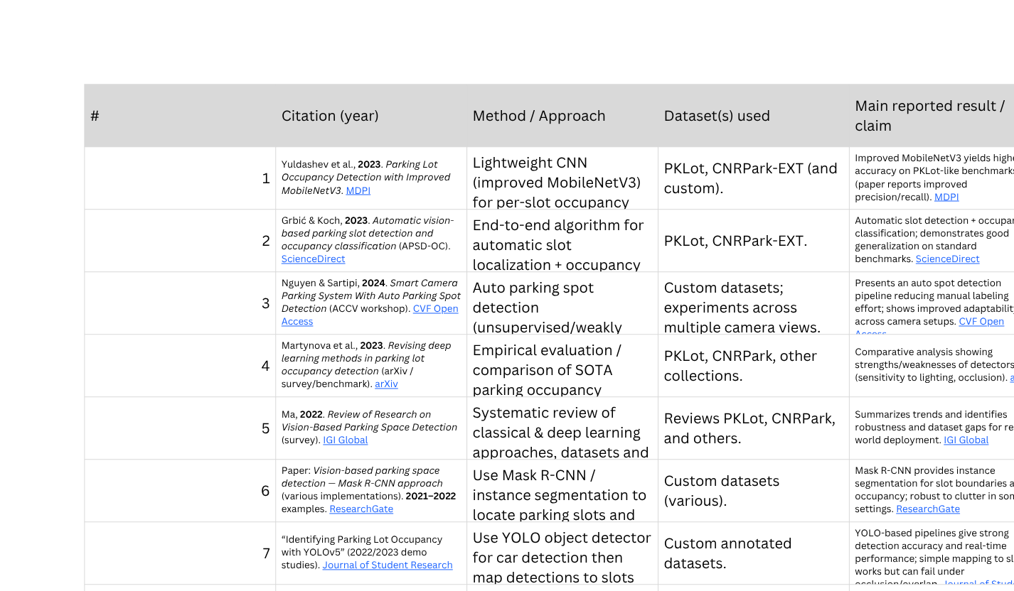
LITERATURE REVIEW
Page 06

Slide 7
PROPOSED SYSTEMS - INTRODUCTION
A real-time Smart Parking system that:
Detects occupancy using CV (YOLO/OpenCV).
Sends real-time updates to a Flask backend.
Stores logs and historical data in MongoDB.
Displays availability on a live dashboard.
Page 07

Slide 8
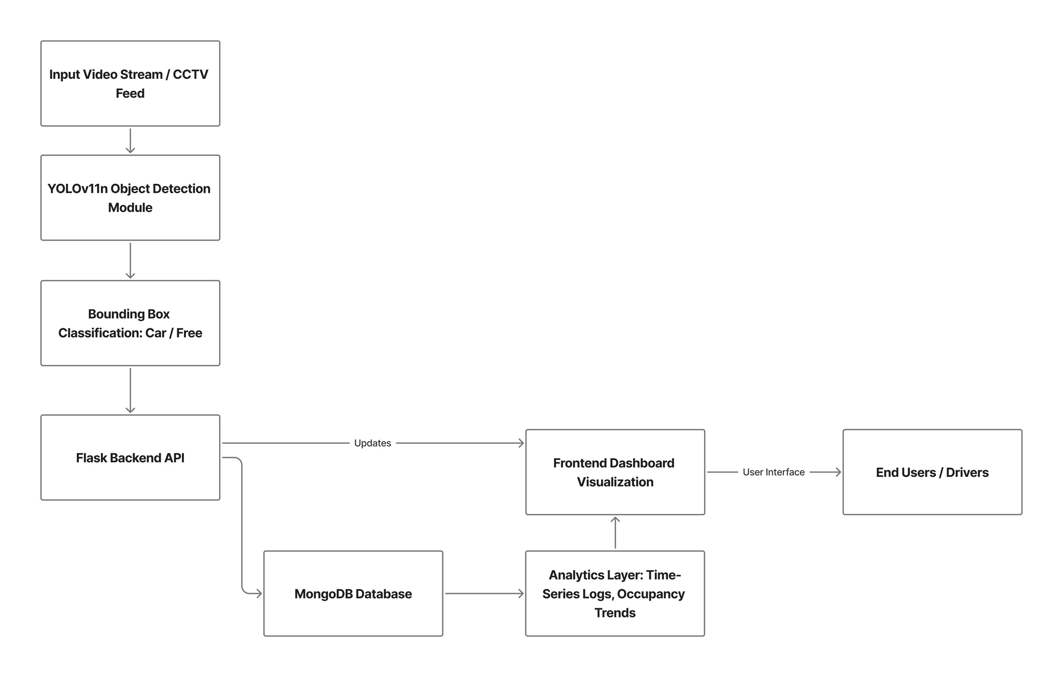
PROPOSED SYSTEMS - DIAGRAM
Phase 1: Baseline System
Implement a "naive" system with default settings to establish baseline performance metrics.
Phase 2: Iterative Optimization & Benchmarking
Systematically test and measure the impact of different schema, indexing, and aggregation strategies.
Phase 3: Scalability Testing
Simulate increased load (more cameras, more users) to evaluate performance and test sharding.
Workload Simulation
Use Python scripts to mimic high-frequency writes (from YOLO) and concurrent reads (from mobile apps).
Page 08

Slide 9

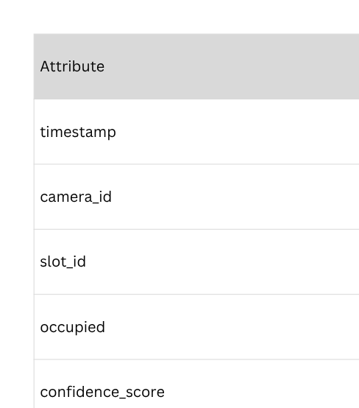

PROPOSED SYSTEMS - DATASET SNAPSHOT
Page 09

Slide 10
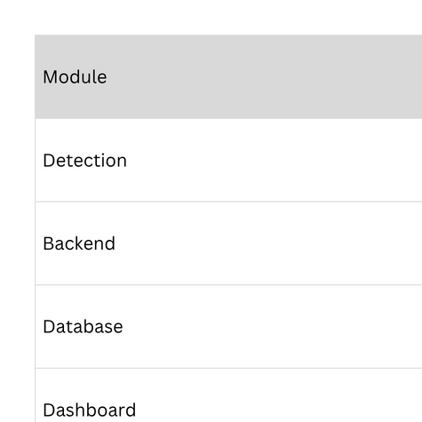
PROPOSED SYSTEMS - LIST OF MODULES
Detection Module (main.py) – Reads live feed, classifies occupancy per slot.
Backend Module (backend_server.py) – REST API, handles data ingestion and queries.
Database Module (MongoDB) – Stores logs, real-time occupancy, metadata.
Frontend Module (Dashboard) – Displays real-time occupancy status and stats.
Analytics Module – Performs aggregation queries (availability trends, peak hours).
Page 10

Slide 11
RESULTS
Model: YOLOv11n (Nano version)
Epochs Trained: 100
Final Precision: 0.966
Final Recall: 0.919
mAP@0.5: 0.949
mAP@0.5:0.95: 0.775
Dataset Classes: Car, Free
The model achieved strong accuracy with low overfitting.
Page 11

Slide 12
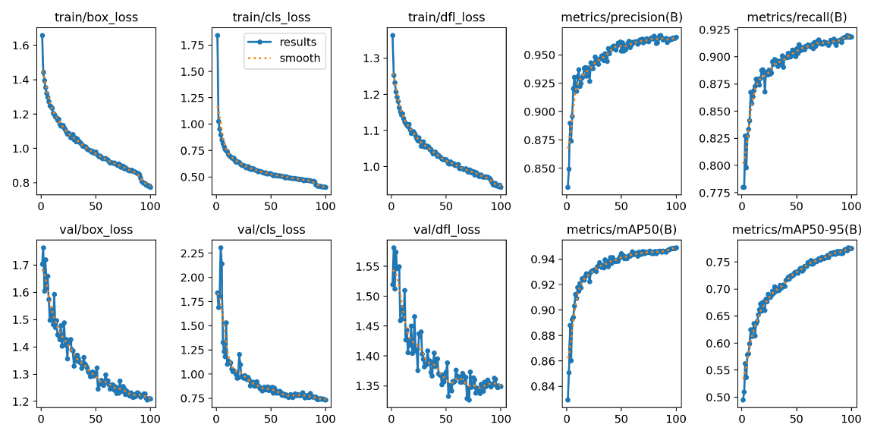
TRAINING METRICS AND LOSS CURVES
Page 12

Slide 13
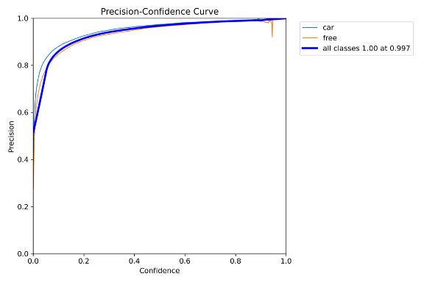
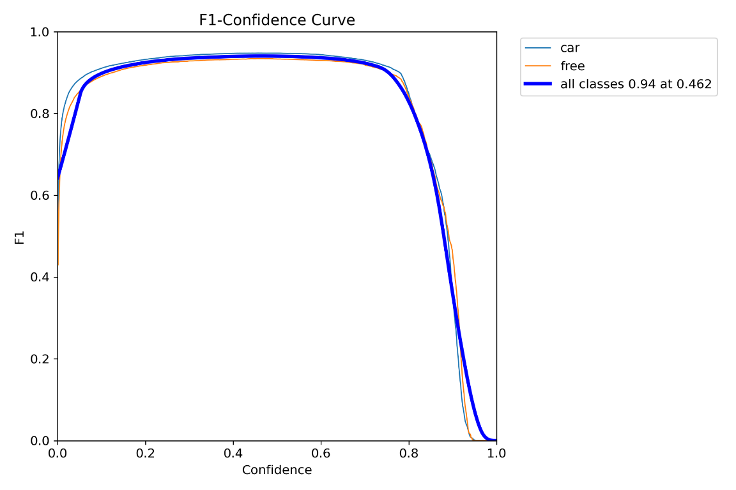
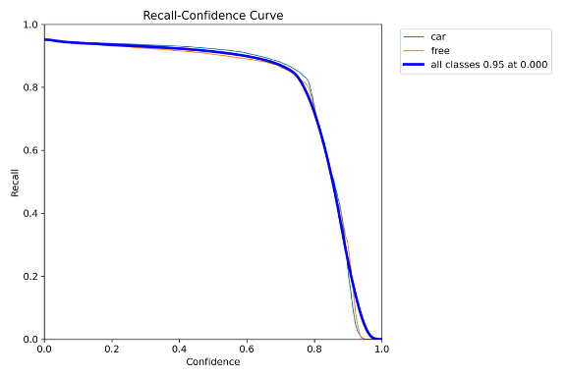
PRECISION, RECALL, AND F1 CURVES
Page 13

Slide 14
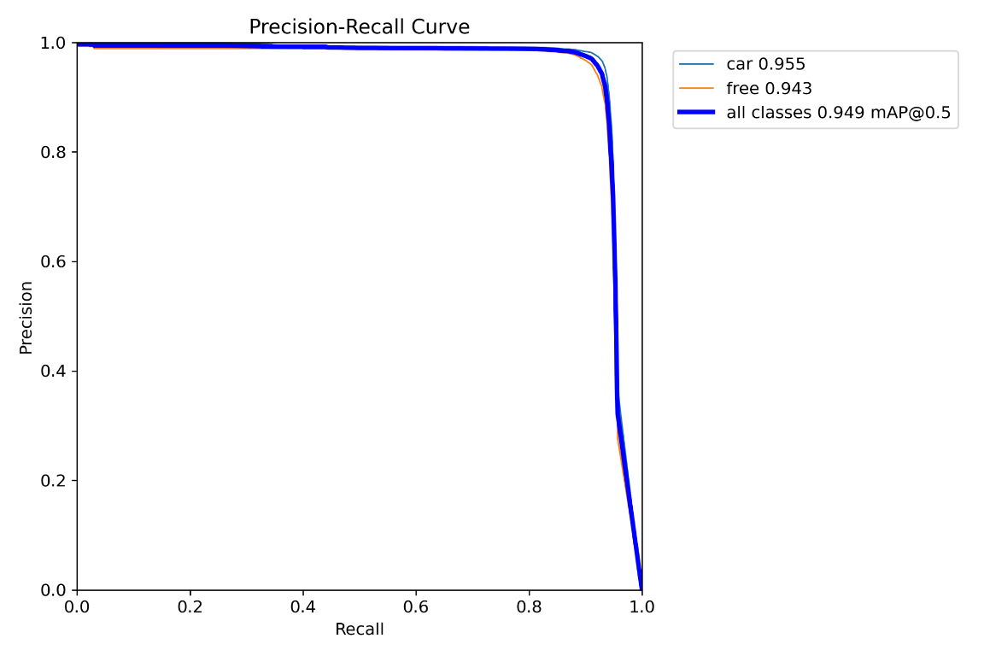
PRECISION-RECALL CURVE
Page 14

Slide 15
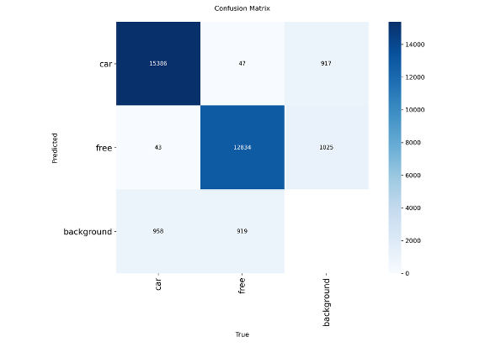
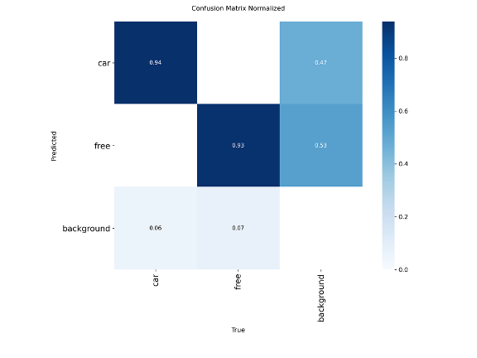
CONFUSION MATRICES
Page 15

Slide 16
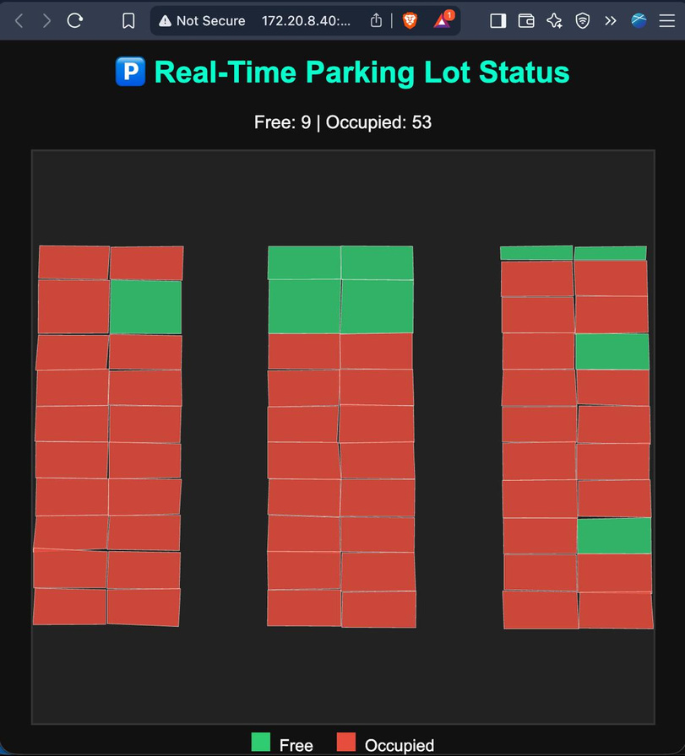
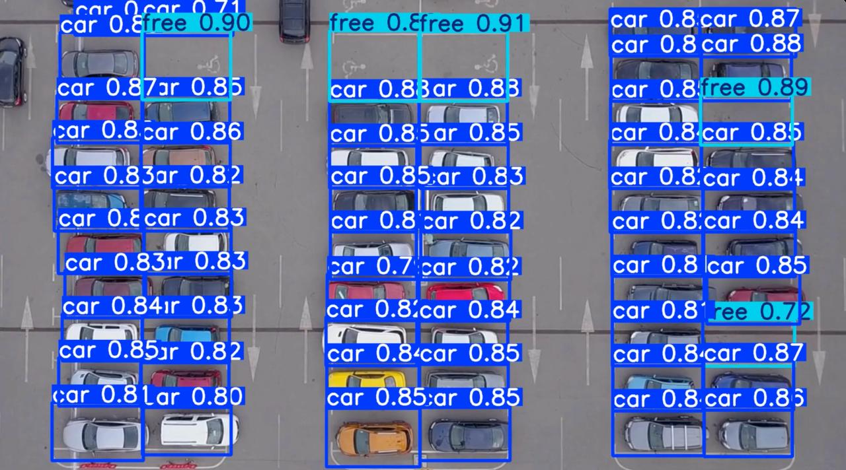
WORKING
Page 16

Slide 17
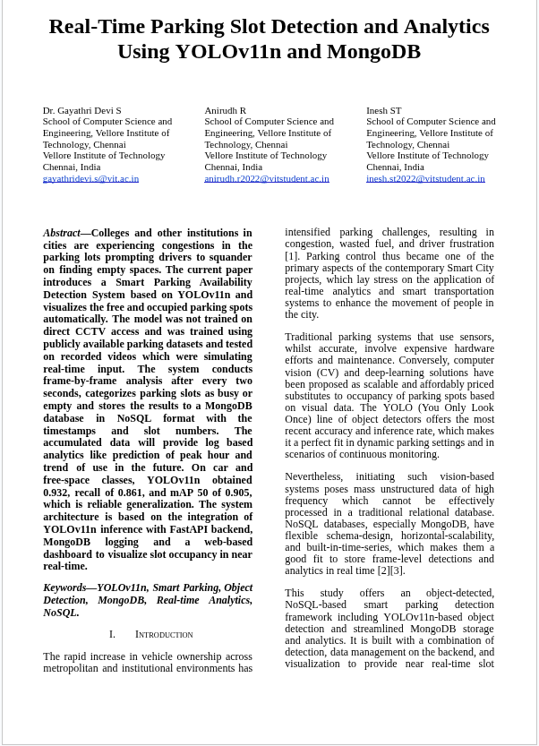
RESEARCH PAPER STATUS
Paper title
“Real-Time Parking Slot Detection and Analytics Using YOLOv11n and MongoDB”
Status:
Literature review completed (14 papers)
Paper writing and formatting completed in IEEE style
Results, MongoDB integration, and dashboard visualization included
Proofread and finalized for submission
Status: Final Version – Ready for Submission
Page 17

Slide 18
REFERENCES
[1] J. Redmon, S. Divvala, R. Girshick, and A. Farhadi, “You Only Look Once: Unified, Real-Time Object Detection,” Proc. IEEE Conference on Computer Vision and Pattern Recognition (CVPR), pp. 779–788, 2016.
[2] L. da Luz, R. Costa, and P. Fernandes, “Smart Parking with Pixel-Wise ROI Selection for Vehicle Detection Using YOLOv8–YOLOv11,” arXiv preprint, arXiv:2412.01983, 2024.
[3] W. Jiang, Z. Liu, and M. Chen, “Two-Stage Efficient Parking Space Detection Method,” Applied Sciences (MDPI), vol. 15, no. 3, pp. 1123–1136, 2025.
[4] E. I. Vlahogianni, M. G. Karlaftis, and J. C. Golias, “Real-Time Parking Availability Prediction in Urban Mobility Systems,” Transportation Research Part C, vol. 142, pp. 104–118, 2022.
[5] B. F. Cooper, A. Silberstein, E. Tam, R. Ramakrishnan, and R. Sears, “Benchmarking Cloud Serving Systems with YCSB,” Proc. ACM Symposium on Cloud Computing (SoCC), pp. 143–154, 2010.
[6] V. Abramova and J. Bernardino, “Benchmarking NoSQL Databases: Cassandra vs. MongoDB vs. HBase,” Proc. TPCTC Workshop on Performance Evaluation and Benchmarking, pp. 24–37, 2014.
[7] A. Davoudian, L. Chen, and M. Liu, “A Survey on NoSQL Data Stores,” ACM Computing Surveys, vol. 51, no. 2, pp. 1–43, 2018.
[8] E. I. Vlahogianni, M. Karlaftis, and J. Golias, “A Real-Time Parking Prediction System for Smart Cities,” Journal of Intelligent Transportation Systems (JITS), vol. 20, no. 5, pp. 475–485, 2016.
[9] N. Rizvi, S. Yadav, and A. Patel, “IoT-Based Smart Parking System for Urban Environments,” IEEE Access, vol. 11, pp. 81234–81245, 2023.
[10] M. Ahmed, F. Rahman, and T. Zaki, “Real-Time Smart Parking System Using YOLO11 and OpenCV,” ResearchGate Preprint, 2025.
[11] K. Yuldashev, A. Lee, and H. Kim, “Parking Lot Occupancy Detection with Improved MobileNetV3,” Sensors (MDPI), vol. 23, no. 4, pp. 1671–1682, 2023.
[12] J. Grbić and S. Koch, “Automatic Vision-Based Parking Slot Detection and Occupancy Classification,” Expert Systems with Applications, vol. 230, pp. 120–139, 2023.
[13] T. Nguyen and K. Sartipi, “Smart Camera Parking System with Auto Parking Spot Detection,” Proc. Asian Conference on Computer Vision Workshops (ACCV Wkshps), pp. 221–230, 2024.
[14] I. Martynova, L. Smirnov, and R. Karpov, “Revising Deep Learning Methods in Parking Lot Occupancy Detection,” arXiv preprint, arXiv:2306.04288, 2023.
[15] X. Ma, “Review of Research on Vision-Based Parking Space Detection Methods,” IGI Global Journal of Intelligent Systems, pp. 45–61, 2022.
[16] R. Cattell, “Scalable SQL and NoSQL Data Stores,” ACM SIGMOD Record, vol. 39, no. 4, pp. 12–27, 2011.
[17] A. Lakshman and P. Malik, “Cassandra: A Decentralized Structured Storage System,” ACM SIGOPS Operating Systems Review, vol. 44, no. 2, pp. 35–40, 2010.
Page 18

Slide 19
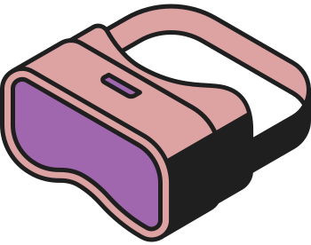



THANK YOU
Page 19

